Slide 1
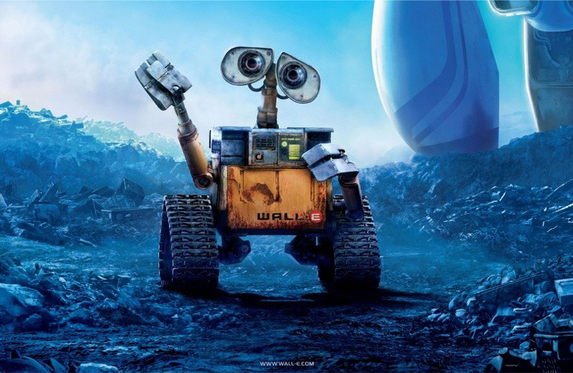
Rational Agents (Chapter 2)

Slide 2
Outline
Agent function and agent program
Rationality
PEAS (Performance measure, Environment, Actuators, Sensors)
Environment types
Agent types

Slide 3
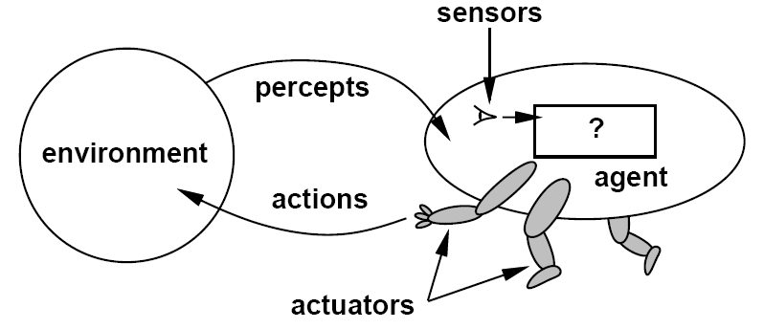
Agents
An agent is anything that can be viewed as perceiving its environment through sensors and acting upon that environment through actuators

Slide 4
Agent function
The agent function maps from percept histories to actions
The agent program runs on the physical architecture to produce the agent function
agent = architecture + program

Slide 5
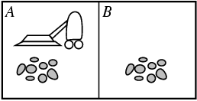
Vacuum-cleaner world
Percepts: Location and status, e.g., [A,Dirty]
Actions: Left, Right, Suck, NoOp
Example vacuum agent program:
function Vacuum-Agent([location,status]) returns an action
if status = Dirty then return Suck
else if location = A then return Right
else if location = B then return Left

Slide 6
Rational agents
For each possible percept sequence, a rational agent should select an action that is expected to maximize its performance measure, given the evidence provided by the percept sequence and the agent’s built-in knowledge
Performance measure (utility function): An objective criterion for success of an agent's behavior

Slide 7
What does rationality mean?
Rationality is not omniscience
Percepts may not supply all the relevant information
Consequences of actions may be unpredictable
Agents can perform actions in order to modify future percepts so as to obtain useful information (information gathering, exploration)
An agent is autonomous if its behavior is determined by its own experience (with ability to learn and adapt)

Slide 8
Back to vacuum-cleaner world
Percepts: Location and status, e.g., [A,Dirty]
Actions: Left, Right, Suck, NoOp
function Vacuum-Agent([location,status]) returns an action
if status = Dirty then return Suck
else if location = A then return Right
else if location = B then return Left
Is this agent rational?
Depends on performance measure, environment properties

Slide 9
Specifying the task environment
Problem specification: Performance measure, Environment, Actuators, Sensors (PEAS)
Example: automated taxi driver
Performance measure
Safe, fast, legal, comfortable trip, maximize profits
Environment
Roads, other traffic, pedestrians, customers
Actuators
Steering wheel, accelerator, brake, signal, horn
Sensors
Cameras, sonar, speedometer, GPS, odometer, engine sensors, keyboard

Slide 10
Agent: Part-sorting robot
Performance measure
Percentage of parts in correct bins
Environment
Conveyor belt with parts, bins
Actuators
Robotic arm
Sensors
Camera, joint angle sensors

Slide 11
Agent: Spam filter
Performance measure
Minimizing false positives, false negatives
Environment
A user’s email account
Actuators
Mark as spam, delete, etc.
Sensors
Incoming messages, other information about user’s account

Slide 12
Environment types
Fully observable (vs. partially observable): The agent's sensors give it access to the complete state of the environment at each point in time
Deterministic (vs. stochastic): The next state of the environment is completely determined by the current state and the agent’s action
Strategic: the environment is deterministic except for the actions of other agents
Episodic (vs. sequential): The agent's experience is divided into atomic “episodes,” and the choice of action in each episode depends only on the episode itself

Slide 13
Environment types
Static (vs. dynamic): The environment is unchanged while an agent is deliberating
Semidynamic: the environment does not change with the passage of time, but the agent's performance score does
Discrete (vs. continuous): The environment provides a fixed number of distinct percepts, actions, and environment states
Time can also evolve in a discrete or continuous fashion
Single agent (vs. multi-agent): An agent operating by itself in an environment
Known (vs. unknown): The agent knows the rules of the environment

Slide 14
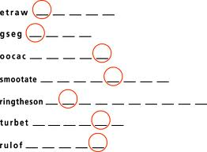
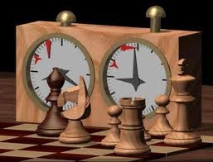
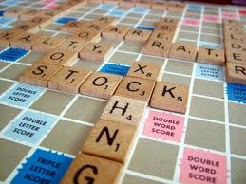
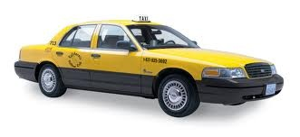
Examples of different environments
Word jumble solver
Chess with a clock
Scrabble
Taxi driving
Fully
Fully
Partially
Partially
Observable
Deterministic
Episodic
Static
Discrete
Single agent
Deterministic
Strategic
Stochastic
Stochastic
Episodic
Sequential
Sequential
Sequential
Static
Semidynamic
Static
Dynamic
Discrete
Discrete
Discrete
Continuous
Single
Multi
Multi
Multi

Slide 15
Hierarchy of agent types
Simple reflex agents
Model-based reflex agents
Goal-based agents
Utility-based agents

Slide 16
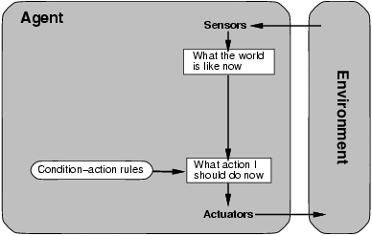
Simple reflex agent
Select action on the basis of current percept, ignoring all past percepts

Slide 17
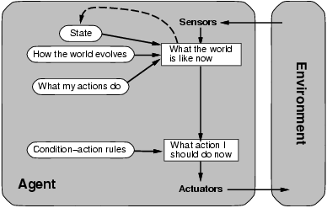
Model-based reflex agent
Maintains internal state that keeps track of aspects of the environment that cannot be currently observed

Slide 18
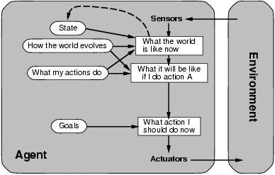
Goal-based agent
The agent uses goal information to select between possible actions in the current state

Slide 19
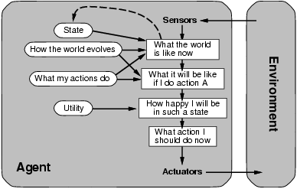
Utility-based agent
The agent uses a utility function to evaluate the desirability of states that could result from each possible action

Slide 20
Where does learning come in?

